Slide 1
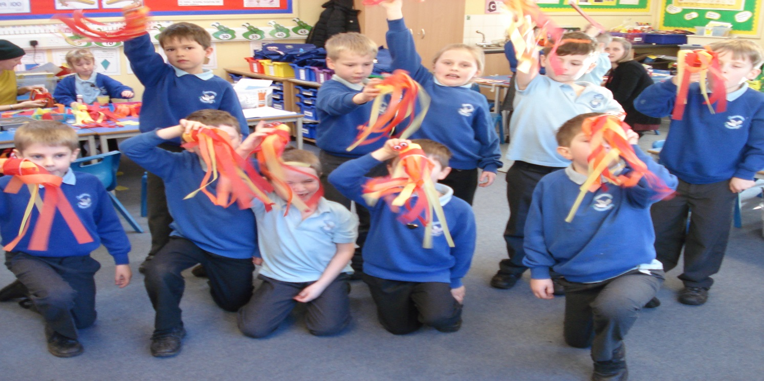
Holy Trinity Catholic School Headteacher’s Report to Governors Spring 2016

Slide 2
Staffing
Staff
Tammy Lawson our SEN 1:1 TA has got a permanent position at St Mary’s and left at half term.
She will be replaced Mon-Wed by Emma Hergt, Thurs- Year 2 TA and on a Friday by Emily Jones. (all current members of staff)
We had our first interview on Monday 8th Feb for our direct teaching position. Unfortunately, all places are now full.
Mrs Hovard is not likely to return to work until after the Easter Break. (LB and CP both working in the office)

Slide 3
School Numbers
Number on roll | No for 2016 intake | FS2 | Year 1 | Year 2 | Year 3 | Year 4 | Year 5 | Year 6
 | 46 1st choice | 30 | 29 | 25 | 30 | 31 | 25 | 27
No of Catholics | unknown | 7 | 12 | 6 | 10 | 7 | 10 | 3
Basic characteristics of the school
Characteristics | National | School | Comparison
Number on roll | 269 | 197 | below
%free school meals | 26 | 2.6 | low
%pupils from minority ethnic groups | 30.7 | 7.7 | Very low
%EAL | 19.5 | 3 | Very low
Deprivation indicator | 0.24 | 0.10 | low
Average point score in Year 6 in 2015 | 28.8 | 31.2 | Above average
Pupils with SEN support | 13 | 14.2 | Average

Slide 4
Pupil Premium expenditure Total allocated for 2015-2016 £22,500
Focus on Learning in the curriculum 28%
Focus on social, emotional and behaviour 26%
Focus on enrichment beyond the curriculum 15%
Focus on early intervention: 31%
Action
Allocation |  | Desired Impact / Outcome
TA small group /individual support 3 days each week £1900 spent to date | £3,870 | Emotional and social well-being of targeted pupils. Increase in pupil confidence and self esteem. To improve pupils’ achievement
2 x Additional teacher ½ day £2,900 spent to date | £4,950 | To improve pupil achievement by accelerating progress
Purchase of ICT equipment £1,500 on Ipads, although total amount spent £4,500. | £1,500 | To improve pupils’ achievement, motivate reluctant readers to writers
Teacher one to one support | £1,050 | Improved results Pupil progress meetings 3 x annually
Employment of PSA 3 days a week | £2,950 | For social and emotional well being of children and parents
Resources: KS2 Guided reading scheme Maths (models and images) £1,000 spent so far | £1,370 £1,000 | To help children develop a sense of number order and number pattern
Financial support for Residential Trip and curriculum enhancement days £500 spent so far, possible over spend | £560 | Pupil and parental feedback
Theatre Bursary £450 spent | £900 | Pupil Feedback
Contribution Educational Psychologist | £750 | Expertise and help to meet the needs of children
Continuing Professional Development: including Inclusive Strategies training £550 spent so far | £600 | More effective planning and teaching to meet the needs of all children
Total Total spent up to February 2016- £10,800 | £19,500

Slide 5
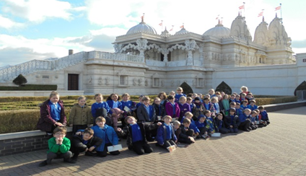
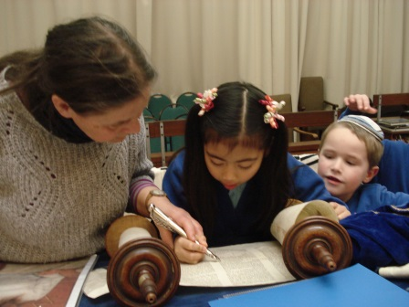
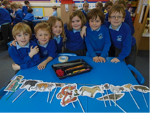
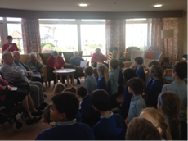
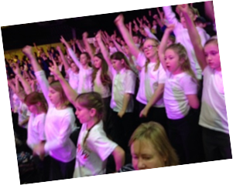
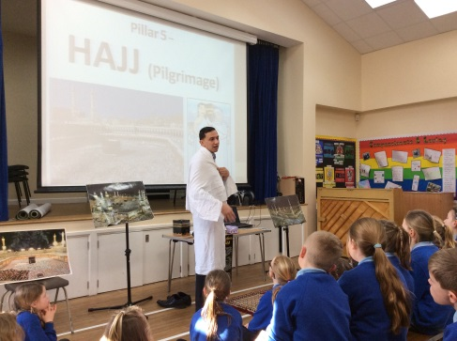
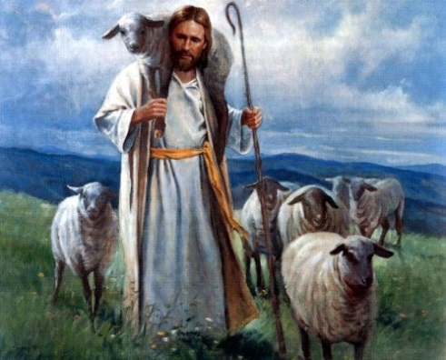
Just some of the events in Spring Term
Years 1 and 2 visit to the Synagogue
Chinese New Year
Year 3 and 4 Neasden Temple visit
Dignity in Action day
Year 3 and 4 Ball Skills
Muslim visitor to Year 5 and 6
Good Shepherd assembly for the start of Lent
Young Voices in Birmingham
Fair Trade fortnight with Fair Trade bake off and afternoon tea
Mother’s Day assembly

Slide 6
Assessment
February Parents’ evenings went very well with all parents receiving highlighted Spring end of year objectives for their children.
Second pupil progress meetings have taken place and children who require early interventions have been identified.
Action plans written for certain year groups

Slide 7
Staff Development
Insets this term have focussed on:
RE, Maths, Gifted and Talented, Science, SEND, New Assessment procedures.
Training undertaken in Autumn
OPT training
Arts Mark
Fire awareness
Every Child a Writer intervention
NQT courses
New SATs Briefing
ICT coding course
EYFS conference
Headteachers’ Briefing on new SATS

Slide 8
Progress of school development plan
The Progress of Key Priorities within the School Development Plan- Leadership and Management
Objection/Action | On target | Partially on target | Off target | notes
Completion of whole school SEF | √
To challenge the MAC board to exercise its strategic view |  | √
To develop better leadership of learning and teaching | √
Enhance the role of middle leaders | √
Ensure performance management is challenging and fair | √
Enhance the school environment reflecting children’s ideas. | √

Slide 9
Self Evaluation- Leadership and Management
Descriptors | Outstanding | Good | Requires Improvement | Inadequate | Notes
Leaders and governors are committed to setting high expectations | √
Leaders and governors focus consistently on improving outcomes for all pupils |  | √
Leadership promotes equality of opportunity and diversity. | √
Pupils’ spiritual, moral, social and cultural development as well as British values are at the heart of the school | √
Safeguarding is effective including protecting pupils from radicalisation and extremism | √
There is effective deployment of Pupil Premium, SEND, Sports grant funding. | √

Slide 10
Self-Evaluation- Leadership and Management
Area | Grade
 | outstanding | Good | Requires improvement | Inadequate
Leadership and Management | √
Strengths
Robust yet supportive performance management system- teaching and its impact on learning is evaluated formally each term.
Development of middle leaders
Pupils’ attainment and achievement- monitored termly to ensure high standards are sustained and improved on.
The school’s development plan is focussed and identifies the school’s many strengths and provides a perceptive view of areas for further development.
Audits- This year’s annual H&S, and finance audits have been very good.
Staff well being survey was excellent
Governors’ Impact- Governors continue to closely monitor the school and challenge the Head
Strong engagement with families- through the newsletter, coffee mornings, parent questionnaires. Parents feel that their views are valued and used to improve the school further.
Pupil voice- New junior leadership team to meet senior leadership team fortnightly for a working lunch, discussing key priorities for the children and school.
Priorities for Improvement
Additional opportunities for families to feed into the school improvement cycle
Succession planning for SLT
To improve links with the parish once the new priest has arrived.

Slide 11
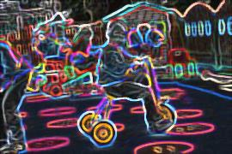
The Outcomes of pupils at the school

Slide 12
Forecast Data for summer 2016
EYFS | GLD | > 83%
Year 1 | Phonic Screening | >80%
 |  | Reading Writing Maths
Year 2 | Sats | 92% | 88% | 90%
Year 6 | Sats | 92% | 92% | 92%

Slide 13
Self Evaluation- Outcomes for pupils
 | Outstanding | Good | Requires Improvement | Inadequate | Notes
The progress across the curriculum of disadvantaged pupils, SEND is improving towards that of other pupils. | √
From each starting point, the proportions of pupils making and exceeding expected progress in English and Maths are high national figures. | √ | √ |  |  | 1
The attainment of almost all groups of pupils is broadly in line with national averages | √
Pupils are exceptionally well prepared for the next stage of education | √
Throughout each year group and across the curriculum current pupils make substantial and sustained progress. |  | √ |  |  | 2
1. Year 6 cohort last year achieved significantly above national figures in KS1 results which meant that achieving better than expected progress was very difficult as children need to gain a level 6.
100% of children achieved expected progress in all subjects.
2. New assessment in place this year and only had one pupil progress meeting so difficult to assess progress within year. However, last year all year groups made good progress but this year there is a focus on improving progress in Lower Key Stage 2.

Slide 14
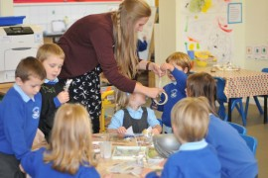
Early Years

Slide 15
2014-2015
 | Holy Trinity | Local Authority (2014 figures)
GLD | 83% | 60%
APS | 34.3 | 33.6
2015-2016 GLD | Forecast to be equal or better than last year’s data.
Average point scores (APS) shown here are for the EYFS profile only and do not equate to National Curriculum levels. The maximum possible point score for an incredibly able child would be 51. An average child might be expected to score 34 points.
A ‘good level of development’ (GLD) is deemed to be a child achieving EXPECTED in all prime areas plus Literacy and Mathematics.
Our EYFS exit score and GLD compare well to the LA and National figures (2014) .

Slide 16
Self Evaluation- Effectiveness of the Early Years
Descriptors | Outstanding | Good | Requires Improvement | Inadequate | Notes
Highly successful drive to improve outcomes and maintain the highest levels of outcome | √
Effective safeguarding | √
High engagement of parents | √ |  |  |  | 1 3
Children are motivated and eager to join in | √
Children make consistently high rates of progress | √ |  |  |  | 2
Assessment is accurate and based on high quality observations | √
Regular coffee morning for parents, Parents invited into school
Statutory test are on track for last year’s achievement.

Slide 17
Personal development, behaviour and welfare

Slide 18
Attendance
December January February
 | % Attendance
Foundation | 96.76
Year 1 | 97.08
Year 2 | 92.62
Year 3 | 96.67
Year 4 | 95.29
Year 5 | 97.85
Year 6 | 98.0
 | Attendance
Foundation | 95.66%
Year 1 | 94.65%
Year 2 | 95.01%
Year 3 | 95.77%
Year 4 | 94.46%
Year 5 | 97.1%
Year 6 | 95.70%
 | Attendance
Foundation | 91.76%
Year 1 | 97.24%
Year 2 | 93.06%
Year 3 | 98.33%
Year 4 | 95.39%
Year 5 | 95.33%
Year 6 | 97.01%
Attendance in school was a lot lower in January and February due to a number of D&V bugs. At some points a quarter of the classes were missing.

Slide 19
Behaviour Report
 | September | October | November | December | January | February
Level 2 incidents | 4 | 5 | 4 | 3 |  | 1
Level 3 incidents |  |  |  | 1 | 1 | 2
Level 4 Fixed Term Exclusion |  |  | 1 | 1 | 1
Racist and bullying incidents (from 1st September- 17.11.15) | Upto December | Upto February
Number of racist incidents | 0 | 0
Bullying incidents | 1 | 1

Slide 20
SEND at Holy Trinity
We have 28 children who are on the SEND register, we offer support in a variety of ways:
Support | Number of children
CAFs – Common Assessment Framework | 7active, 1 closed and 1 not continuing with
TACs- Team around the Child | 10
SENSS- Special Educational Needs Support Services | 10 referrals
EP-Educational Psychologist | 4
Young Carers | 2
Assessing Witney hub | 4 key workers
PCAMHS | 4 -1 child discharged
CAMHS | 3 referrals accepted
Social care referrals | 6
CHICKS- respite care | 5
Professional meeting | 2
Riding for the disabled | 1
Working with HSLW | 13
Speech and Language | 5 and 2 referrals
Official Wave 2 Interventions | 46 children
Working with a Quality First Teacher- QFT | 10
Gifted and Talented booster groups | 25

Slide 21
The Progress of Key Priorities within the School Development Plan- Personal development, behaviour and welfare
Objection/Action | On target | Partially on target | Off target | notes
Revisit the school’s behavioural policy | √
To continue to improve rates of attendance |  |  | √ | 3
To develop a whole school approach to internet safety | √ |  |  | 1
To monitor and develop pupils’ attitude to learning |  | √ |  | 2
To improve the process of monitoring serious incidents |  | √
E-Safety workshops for parents and all Key Stage 1 and 2 children have taken place in this Autumn term. New e-safety posters put up in all classrooms and new e-safety policy has been implemented. Revisited in Spring 1 KS2 assembly
Pupil voice questionnaires have gone out but have yet to be analysed.
Attendance has been lower in Jan and Feb due to a number of bugs in school.

Slide 22
Self-evaluation- On the Effectiveness of Personal Development, Behaviour and Welfare
Descriptors | Outstanding | Good | Requires Improvement | Inadequate | Notes
Pupils are confident, self assured leaners | √
Pupils discussions and debates show respect for others’ ideas and points of view | √
Pupils value their education and attendance is good for all groups |  | √ |  |  | 1
Pupils’ impeccable conduct reflects the school’s strategies to promote high standards of behaviour | √ |  |  |  | 2
School works hard to prevent all forms of bullying | √
Pupils can explain accurately how to keep themselves healthy | √
Pupils’ spiritual, moral, social and cultural development equips them to be thoughtful, caring and active citizens in school and the wider community. | √
Pupils feel safe | √
We have had a number of requests from parents asking for holidays during term time. These have all been declined and if taken it has been an unauthorised absence.
Pupils behaviour is very good but we always feel there is room for improvement.

Slide 23
Effectiveness of teaching, learning and assessment

Slide 24
Quality of teaching, learning and assessment
Priorities for Spring 2016
Maintain outstanding teaching
Additional support for Lower Key Stage 2 classes
Continued support for Upper Key Stage 2 classes
Ensure targets are displayed in classrooms and in children’s books

Slide 25
Self evaluation on the quality of teaching, learning and assessment
Descriptors | Outstanding | Good | Requires Improvement | Inadequate | notes
Teachers demonstrate deep knowledge and understanding of the subjects they teach. | √
Teachers plan effective lessons maximising lesson time |  | √ | √
Teachers check pupils understanding | √
Teachers’ feedback is in line with school policy and pupils know how to improve their work. |  | √
Pupils are eager to improve their learning and capitalise on opportunities to use feedback |  | √
Excellent cross curricular links | √
Parents are provided with clear and timely information on how well their child is progressing | √

Slide 26
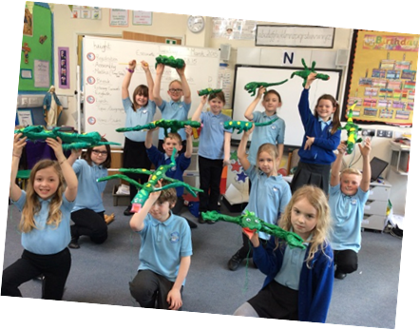
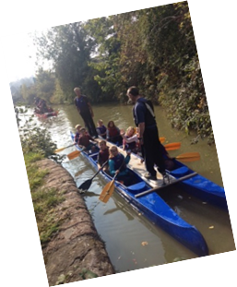
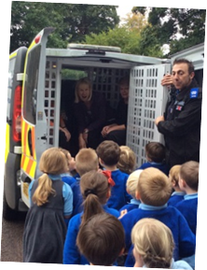
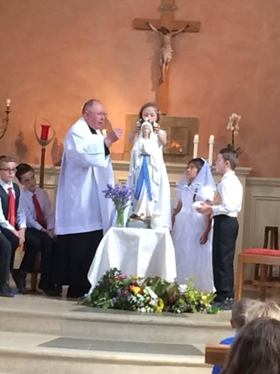
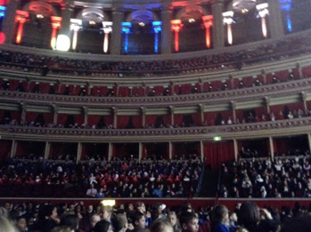
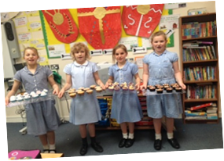
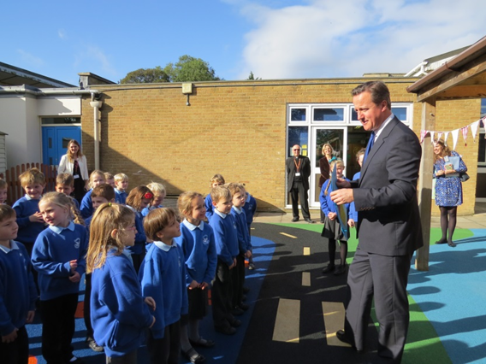
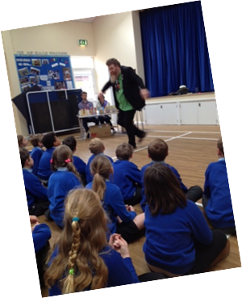
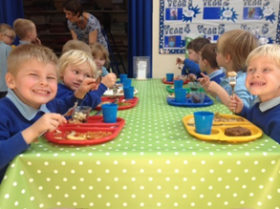
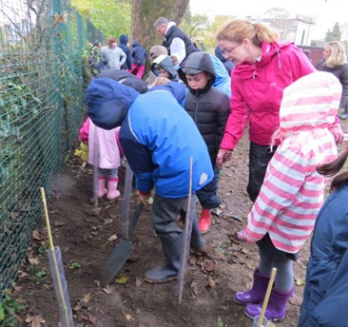
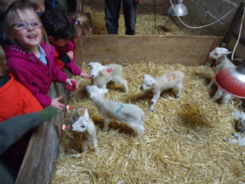
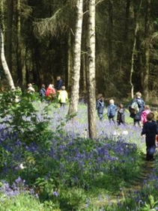
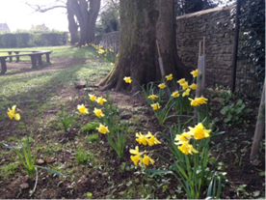
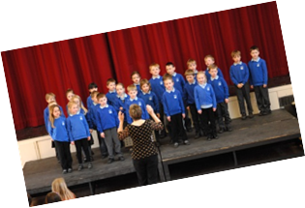
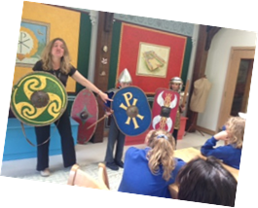
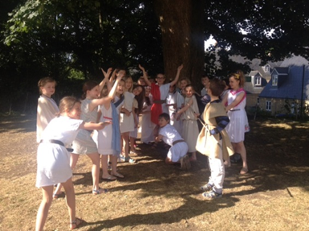
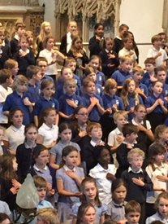
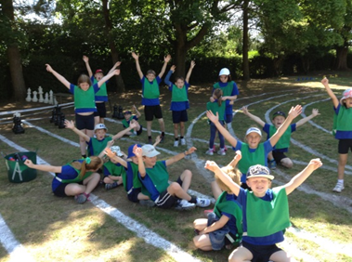
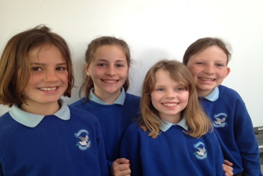
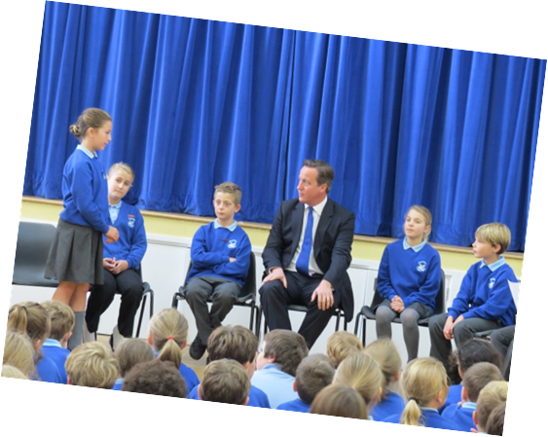
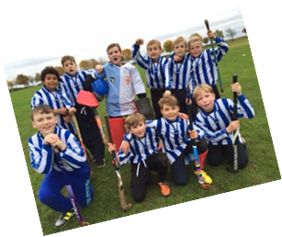
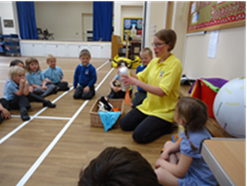
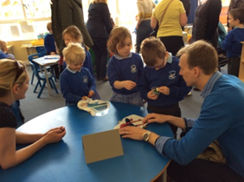
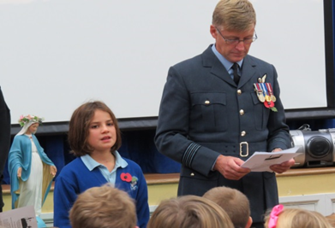
Our school
Mock election

Slide 27
Overall Effectiveness
Descriptors | Outstanding | Good | Requires Improvement | Inadequate
The Quality of teaching, learning and assessment |  | √
All other judgements are likely to be outstanding | √
The school’s thoughtful and wide-ranging promotion of pupils’ spiritual, moral, social and cultural development enables pupils to thrive | √
Safeguarding is effective | √

